Slide 1
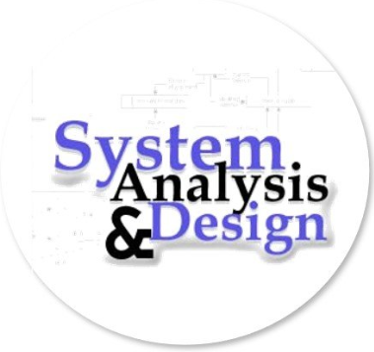
SYSTEM ANALYSIS & DESIGN
LECTURER: SUMAN THAPALIYA

Slide 2
UNIT 1: OBJECTIVES
OVERVIEW OF SYSTEM ANALYSIS & DESIGN
Introduction to System Analysis and Design
Information Systems and It’s Types
Stakeholders of Information Systems
Systems Development Life Cycle and Life Cycle Models
Waterfall
Spiral
Prototype
DSDM
SSADM
RAD
JAD

Slide 3
INTRODUCTION TO SYSTEM ANALYSIS & DESIGN
Firstly we will define the system, than system analysis and system design as well.
SYSTEM
A Set of detailed methods, procedures and routines established or formulation to carry out specify activity perform a duty or solve a problem.

Slide 4
SYSTEM ANALYSIS
It is a process of collecting and interpreting facts, identifying the problems, and decomposition of a system into its components.
System analysis is conducted for the purpose of studying a system or its parts in order to identify its objectives. It is a problem solving technique that improves the system and ensures that all the components of the system work efficiently to accomplish their purpose.
Analysis specifies what the system should do.

Slide 5
SYSTEM DESIGN
It is a process of planning a new business system or replacing an existing system by defining its components or modules to satisfy the specific requirements. Before planning, you need to understand the old system thoroughly and determine how computers can best be used in order to operate efficiently.
System Design focuses on how to accomplish the objective of the system.
System Analysis and Design (SAD) mainly focuses on −
Systems
Processes
Technology

Slide 6
WHAT IS A SYSTEM
The word System is derived from Greek word Systema, which means an organized relationship between any set of components to achieve some common cause or objective.
A system is “an orderly grouping of interdependent components linked together according to a plan to achieve a specific goal.”

Slide 7
CONSTRAINTS OF A SYSTEM
A system must have three basic constraints −
A system must have some structure and behavior which is designed to achieve a predefined objective.
Interconnectivity and interdependence must exist among the system components.
The objectives of the organization have a higher priority than the objectives of its subsystems.
For example, traffic management system, payroll system, automatic library system, human resources information system.

Slide 8
PROPERTIES OF A SYSTEM
Organization
Organization implies structure and order. It is the arrangement of components that helps to achieve predetermined objectives.
Interaction
It is defined by the manner in which the components operate with each other.
For example, in an organization, purchasing department must interact with production department and payroll with personnel department.
Interdependence
Interdependence means how the components of a system depend on one another. For proper functioning, the components are coordinated and linked together according to a specified plan. The output of one subsystem is the required by other subsystem as input.

Slide 9
Integration
Integration is concerned with how a system components are connected together. It means that the parts of the system work together within the system even if each part performs a unique function.
Central Objective
The objective of system must be central. It may be real or stated. It is not uncommon for an organization to state an objective and operate to achieve another.
The users must know the main objective of a computer application early in the analysis for a successful design and conversion.

Slide 10
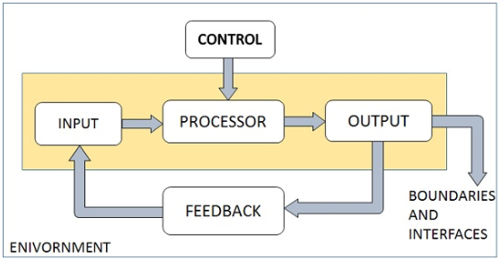
ELEMENTS OF A SYSTEM
The following diagram shows the elements of a system −

Slide 11
Outputs and Inputs
The main aim of a system is to produce an output which is useful for its user.
Inputs are the information that enters into the system for processing.
Output is the outcome of processing.
Processor(s)
The processor is the element of a system that involves the actual transformation of input into output.
It is the operational component of a system. Processors may modify the input either totally or partially, depending on the output specification.
As the output specifications change, so does the processing. In some cases, input is also modified to enable the processor for handling the transformation.
Control
The control element guides the system.
It is the decision–making subsystem that controls the pattern of activities governing input, processing, and output.
The behavior of a computer System is controlled by the Operating System and software. In order to keep system in balance, what and how much input is needed is determined by Output Specifications.

Slide 12
Feedback
Feedback provides the control in a dynamic system.
Positive feedback is routine in nature that encourages the performance of the system.
Negative feedback is informational in nature that provides the controller with information for action.
Environment
The environment is the “supersystem” within which an organization operates.
It is the source of external elements that strike on the system.
It determines how a system must function. For example, vendors and competitors of organization’s environment, may provide constraints that affect the actual performance of the business.
Boundaries and Interface
A system should be defined by its boundaries. Boundaries are the limits that identify its components, processes, and interrelationship when it interfaces with another system.
Each system has boundaries that determine its sphere of influence and control.
The knowledge of the boundaries of a given system is crucial in determining the nature of its interface with other systems for successful design.

Slide 13
TYPES OF SYSTEMS
The systems can be divided into the following types −
Physical or Abstract Systems
Physical systems are tangible entities. We can touch and feel them.
Physical System may be static or dynamic in nature. For example, desks and chairs are the physical parts of computer center which are static. A programmed computer is a dynamic system in which programs, data, and applications can change according to the user's needs.
Abstract systems are non-physical entities or conceptual that may be formulas, representation or model of a real system.
Open or Closed Systems
An open system must interact with its environment. It receives inputs from and delivers outputs to the outside of the system. For example, an information system which must adapt to the changing environmental conditions.
A closed system does not interact with its environment. It is isolated from environmental influences. A completely closed system is rare in reality.

Slide 14
Adaptive and Non Adaptive System
Adaptive System responds to the change in the environment in a way to improve their performance and to survive. For example, human beings, animals.
Non Adaptive System is the system which does not respond to the environment. For example, machines.
Permanent or Temporary System
Permanent System persists for long time. For example, business policies.
Temporary System is made for specified time and after that they are demolished. For example, A DJ system is set up for a program and it is dissembled after the program.

Slide 15
NEEDS FOR SYSTEM ANALYSIS & DESIGN
Installing a system without proper planning leads to great user dissatisfaction and frequently causes the system to fall into disuse.
Lends structure to the analysis and design of information systems
A series of processes systematically undertaken to improve a business through the use of computerized information system.

Slide 16
ROLE OF THE SYSTEM ANALYST
The analyst plays a key role in information systems development projects.
Must understand how to apply technology to solve business problems.
Analyst may serve as change agents who identify the organizational improvement.
Identify, understand and plan for organizational and human impacts of planned systems, and ensure that new technical requirements are properly integrated with existing processes and skill sets.
Plan a system flow from the ground up.
Interact with internal users and customers to learn and document requirements that are then used to produce business required documents.
Write technical requirements from a critical phase.
Interact with software architect to understand software limitations.
Help programmers during system development, e.g. provide use cases, flowcharts, UML and BPMN diagrams.
Document requirements or contribute to user manuals.
Whenever a development process is conducted, the system analyst is responsible for designing components and providing that information to the developer.

Slide 17
Role of System Analyst
The system analyst is a person who is thoroughly aware of the system and guides the system development project by giving proper directions. He is an expert having technical and interpersonal skills to carry out development tasks required at each phase. He pursues to match the objectives of information system with the organization goal.
Main Roles
Defining and understanding the requirement of user through various Fact finding techniques.
Prioritizing the requirements by obtaining user consensus.
Gathering the facts or information and acquires the opinions of users.
Maintains analysis and evaluation to arrive at appropriate system which is more user friendly.
Suggests many flexible alternative solutions, pick the best solution, and quantify cost and benefits.
Draw certain specifications which are easily understood by users and programmer in precise and detailed form.
Implemented the logical design of system which must be modular.
Plan the periodicity for evaluation after it has been used for some time, and modify the system as needed.

Slide 18
QUALITY OF THE SYSTEM ANALYST
Problem Solving Skills: The system analyst should have a wide experience of good problem solving skills and creativity.
Good Communicator: The analyst should have good communication and interpersonal skills. This will help in bridging the gap of communication between the technical staff and non-technical users. The analyst will interact with people at all levels of organization structure.
Strong Personal and Professional Ethics
Self- Disciplined and Self – Motivated
Must have Business Knowledge: A system analyst must clearly understand the environment for which the system is being developed.
Technical Skills: A system analyst must be well trained in relevant areas of computer science such as hardware, software and programming knowledge.

Slide 19
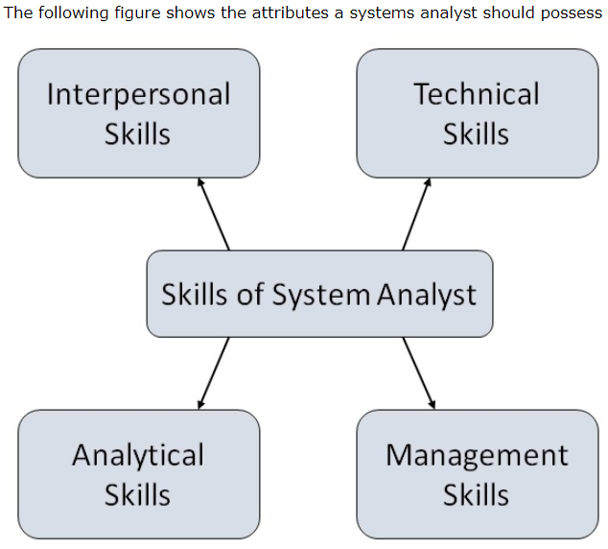
Attributes of a Systems Analyst

Slide 20
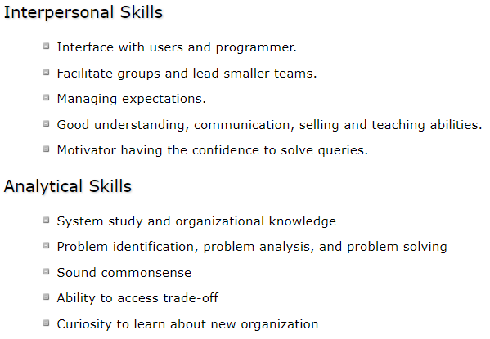
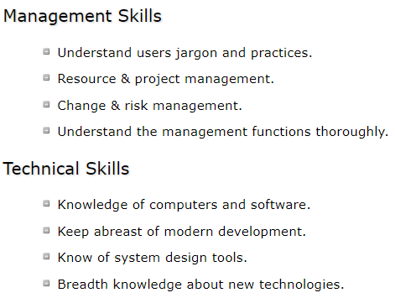

Slide 21
INFORMATION SYSTEM & IT’s TYPES
A typical organization is divided into operational, middle, and upper level. The information requirements for users at each level differ. Towards that end, there are number of information systems that support each level in an organization.
An information system (IS) refers to a collection of multiple pieces of equipment involved in the dissemination of information. Hardware, software, computer system connections and information, information system users, and the system’s housing are all part of an IS.

Slide 22
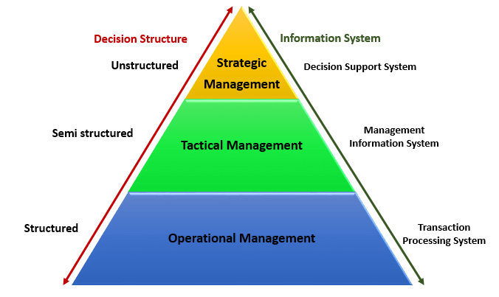
Pyramid Diagram of Organizational levels and information requirements
Understanding the various levels of an organization is essential to understand the information required by the users who operate at their respective levels.
The following diagram illustrates the various levels of a typical organization.

Slide 23
Operational management level
The operational level is concerned with performing day to day business transactions of the organization.
Examples of users at this level of management include cashiers at a point of sale, bank tellers, nurses in a hospital, customer care staff, etc.
Users at this level use make structured decisions. This means that they have defined rules that guides them while making decisions.
For example, if a store sells items on credit and they have a credit policy that has some set limit on the borrowing. All the sales person needs to decide whether to give credit to a customer or not is based on the current credit information from the system.

Slide 24
Tactical Management Level
This organization level is dominated by middle-level managers, heads of departments, supervisors, etc. The users at this level usually oversee the activities of the users at the operational management level.
Tactical users make semi-structured decisions. The decisions are partly based on set guidelines and judgmental calls. As an example, a tactical manager can check the credit limit and payments history of a customer and decide to make an exception to raise the credit limit for a particular customer. The decision is partly structured in the sense that the tactical manager has to use existing information to identify a payments history that benefits the organization and an allowed increase percentage.

Slide 25
Strategic Management Level
This is the most senior level in an organization. The users at this level make unstructured decisions. Senior level managers are concerned with the long-term planning of the organization. They use information from tactical managers and external data to guide them when making unstructured decisions.

Slide 26
Transaction Processing System (TPS)
Transaction processing systems are used to record day to day business transactions of the organization. They are used by users at the operational management level. The main objective of a transaction processing system is to answer routine questions such as;
How printers were sold today?
How much inventory do we have at hand?
What is the outstanding due for John Doe?

Slide 27
By recording the day to day business transactions, TPS system provides answers to the above questions in a timely manner.
The decisions made by operational managers are routine and highly structured.
The information produced from the transaction processing system is very detailed.
For example, banks that give out loans require that the company that a person works for should have a memorandum of understanding (MoU) with the bank. If a person whose employer has a MoU with the bank applies for a loan, all that the operational staff has to do is verify the submitted documents. If they meet the requirements, then the loan application documents are processed. If they do not meet the requirements, then the client is advised to see tactical management staff to see the possibility of signing a MoU.

Slide 28
Examples of transaction processing systems include;
Point of Sale Systems – records daily sales
Payroll systems – processing employees salary, loans management, etc.
Stock Control systems – keeping track of inventory levels
Airline booking systems – flights booking management

Slide 29
Management Information System (MIS)
Management Information Systems (MIS) are used by tactical managers to monitor the organization's current performance status. The output from a transaction processing system is used as input to a management information system.
The MIS system analyzes the input with routine algorithms i.e. aggregate, compare and summarizes the results to produced reports that tactical managers use to monitor, control and predict future performance.
For example, input from a point of sale system can be used to analyze trends of products that are performing well and those that are not performing well. This information can be used to make future inventory orders i.e. increasing orders for well-performing products and reduce the orders of products that are not performing well.

Slide 30
Examples of management information systems include;
Sales management systems – they get input from the point of sale system
Budgeting systems – gives an overview of how much money is spent within the organization for the short and long terms.
Human resource management system – overall welfare of the employees, staff turnover, etc.
Tactical managers are responsible for the semi-structured decision. MIS systems provide the information needed to make the structured decision and based on the experience of the tactical managers, they make judgement calls i.e. predict how much of goods or inventory should be ordered for the second quarter based on the sales of the first quarter

Slide 31
Decision Support System (DSS)
Decision support systems are used by senior management to make non-routine decisions. Decision support systems use input from internal systems (transaction processing systems and management information systems) and external systems.
The main objective of decision support systems is to provide solutions to problems that are unique and change frequently. Decision support systems answer questions such as;
What would be the impact of employees' performance if we double the production lot at the factory?
What would happen to our sales if a new competitor entered the market?
Decision support systems use sophisticated mathematical models, and statistical techniques (probability, predictive modeling, etc.) to provide solutions, and they are very interactive.

Slide 32
Examples of decision support systems include;
Financial planning systems – it enables managers to evaluate alternative ways of achieving goals. The objective is to find the optimal way of achieving the goal. For example, the net profit for a business is calculated using the formula Total Sales less (Cost of Goods + Expenses). A financial planning system will enable senior executives to ask what if questions and adjust the values for total sales, the cost of goods, etc. to see the effect of the decision and on the net profit and find the most optimal way.
Bank loan management systems – it is used to verify the credit of the loan applicant and predict the likelihood of the loan being recovered.

Slide 33
Artificial intelligence techniques in business
Artificial intelligence systems mimic human expertise to identify patterns in large data sets. Companies such as Amazon, Facebook, and Google, etc. use artificial intelligence techniques to identify data that is most relevant to you.
Let's use Facebook as an example, Facebook usually makes very accurate predictions of people that you might know or went with to school. They use the data that you provide to them, the data that your friends provide and based on this information make predictions of people that you might know.
Amazon uses artificial intelligence techniques too to suggest products that you should buy also based on what you are currently getting.
Google also uses artificial intelligence to give you the most relevant search results based on your interactions with Google and your location.
These techniques have greatly contributed in making these companies very successful because they are able to provide value to their customers.

Slide 34
Online Analytical Processing (OLAP)
Online analytical processing (OLAP) is used to query and analyze multi-dimensional data and produce information that can be viewed in different ways using multiple dimensions.
Example of OLAP include;
Let's say a company sells laptops, desktops, and Mobile device. They have four (4) branches A, B, C and D. OLAP can be used to view the total sales of each product in all regions and compare the actual sales with the projected sales.
Each piece of information such as product, number of sales, sales value represents a different dimension
The main objective of OLAP systems is to provide answers to ad hoc queries within the shortest possible time regardless of the size of the datasets being used.

Slide 35
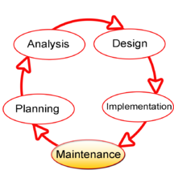
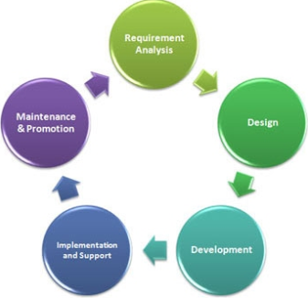
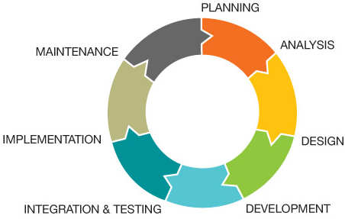
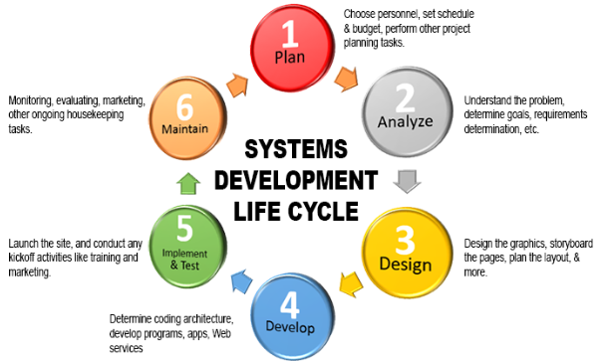
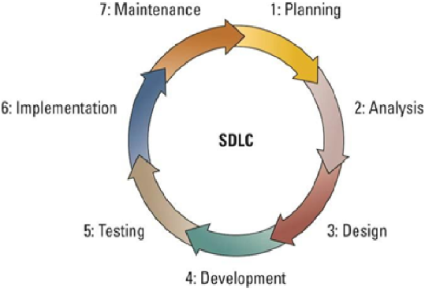
SDLC: SYSTEM DEVELOPMENT LIFE CYCLE

Slide 36
SDLC: SYSTEM DEVELOPMENT LIFE CYCLE
An effective System Development Life Cycle (SDLC) should result in a high quality system that meets customer expectations, reaches completion within time and cost evaluations, and works effectively and efficiently in the current and planned Information Technology infrastructure.
System Development Life Cycle (SDLC) is a conceptual model which includes policies and procedures for developing or altering systems throughout their life cycles.
SDLC is used by analysts to develop an information system.
SDLC includes the following activities −
Requirements
Design
Implementation
Testing
Deployment
Operations
Maintenance

Slide 37
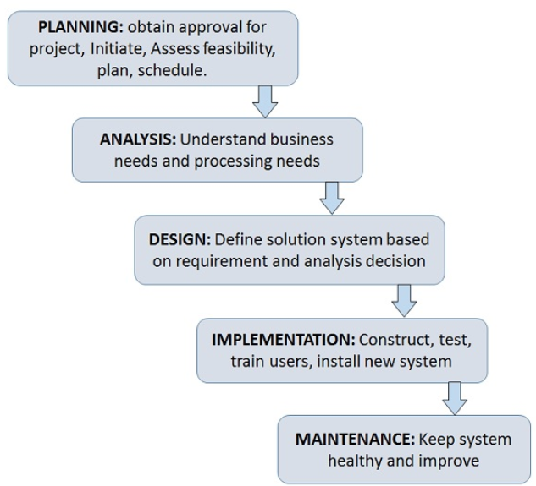
Phases of SDLC
Systems Development Life Cycle is a systematic approach which explicitly breaks down the work into phases that are required to implement either new or modified Information System.

Slide 38
Feasibility Study or Planning
Define the problem and scope of existing system.
Overview the new system and determine its objectives.
Confirm project feasibility and produce the project Schedule.
During this phase, threats, constraints, integration and security of system are also considered.
A feasibility report for the entire project is created at the end of this phase.

Slide 39
Analysis and Specification
Gather, analyze, and validate the information.
Define the requirements and prototypes for new system.
Evaluate the alternatives and prioritize the requirements.
Examine the information needs of end-user and enhances the system goal.
A Software Requirement Specification (SRS) document, which specifies the software, hardware, functional, and network requirements of the system is prepared at the end of this phase.

Slide 40
System Design
Includes the design of application, network, databases, user interfaces, and system interfaces.
Transform the SRS document into logical structure, which contains detailed and complete set of specifications that can be implemented in a programming language.
Create a contingency, training, maintenance, and operation plan.
Review the proposed design. Ensure that the final design must meet the requirements stated in SRS document.
Finally, prepare a design document which will be used during next phases.

Slide 41
Implementation
Implement the design into source code through coding.
Combine all the modules together into training environment that detects errors and defects.
A test report which contains errors is prepared through test plan that includes test related tasks such as test case generation, testing criteria, and resource allocation for testing.
Integrate the information system into its environment and install the new system.

Slide 42
Maintenance/Support
Include all the activities such as phone support or physical on-site support for users that is required once the system is installing.
Implement the changes that software might undergo over a period of time, or implement any new requirements after the software is deployed at the customer location.
It also includes handling the residual errors and resolve any issues that may exist in the system even after the testing phase.
Maintenance and support may be needed for a longer time for large systems and for a short time for smaller systems.

Slide 43
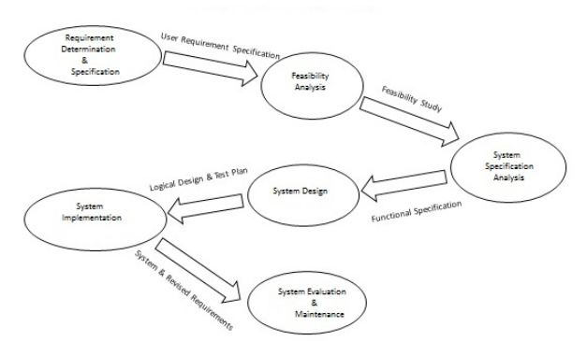
Life Cycle of System Analysis and Design

Slide 44
WATERFALL MODEL
The Waterfall Model was the first Process Model to be introduced. It is also referred to as a linear-sequential life cycle model. It is very simple to understand and use. In a waterfall model, each phase must be completed before the next phase can begin and there is no overlapping in the phases.
The Waterfall model is the earliest SDLC approach that was used for software development.
The waterfall Model illustrates the software development process in a linear sequential flow. This means that any phase in the development process begins only if the previous phase is complete. In this waterfall model, the phases do not overlap.

Slide 45
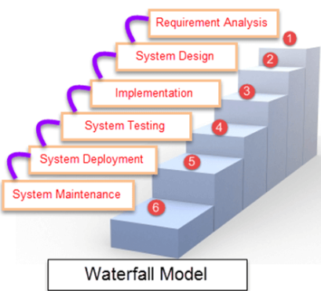
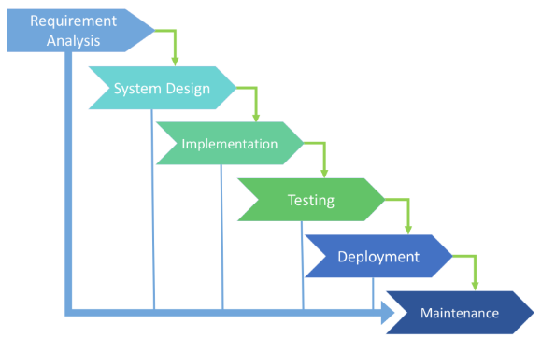

Slide 46
The sequential phases in Waterfall model are
Requirement Gathering and analysis − All possible requirements of the system to be developed are captured in this phase and documented in a requirement specification document.
System Design − The requirement specifications from first phase are studied in this phase and the system design is prepared. This system design helps in specifying hardware and system requirements and helps in defining the overall system architecture.
Implementation − With inputs from the system design, the system is first developed in small programs called units, which are integrated in the next phase. Each unit is developed and tested for its functionality, which is referred to as Unit Testing.
Integration and Testing − All the units developed in the implementation phase are integrated into a system after testing of each unit. Post integration the entire system is tested for any faults and failures.
Deployment of system − Once the functional and non-functional testing is done; the product is deployed in the customer environment or released into the market.
Maintenance − There are some issues which come up in the client environment. To fix those issues, patches are released. Also to enhance the product some better versions are released. Maintenance is done to deliver these changes in the customer environment.
All these phases are cascaded to each other in which progress is seen as flowing steadily downwards (like a waterfall) through the phases. The next phase is started only after the defined set of goals are achieved for previous phase and it is signed off, so the name "Waterfall Model". In this model, phases do not overlap.

Slide 47
Waterfall Model - Application
Every software developed is different and requires a suitable SDLC approach to be followed based on the internal and external factors. Some situations where the use of Waterfall model is most appropriate are −
Requirements are very well documented, clear and fixed.
Product definition is stable.
Technology is understood and is not dynamic.
There are no ambiguous requirements.
Ample resources with required expertise are available to support the product.
The project is long.

Slide 48
Waterfall Model - Advantages
The advantages of waterfall development are that it allows for departmentalization and control. A schedule can be set with deadlines for each stage of development and a product can proceed through the development process model phases one by one.
Development moves from concept, through design, implementation, testing, installation, troubleshooting, and ends up at operation and maintenance. Each phase of development proceeds in strict order.
Some of the major advantages of the Waterfall Model are as follows −
Simple and easy to understand and use
Easy to manage due to the rigidity of the model. Each phase has specific deliverables and a review process.
Phases are processed and completed one at a time.
Works well for smaller projects where requirements are very well understood.
Clearly defined stages.
Well understood milestones.
Easy to arrange tasks.
Process and results are well documented.

Slide 49
Waterfall Model - Disadvantages
The disadvantage of waterfall development is that it does not allow much reflection or revision. Once an application is in the testing stage, it is very difficult to go back and change something that was not well-documented or thought upon in the concept stage.
The major disadvantages of the Waterfall Model are as follows −
No working software is produced until late during the life cycle.
High amounts of risk and uncertainty.
Not a good model for complex and object-oriented projects.
Poor model for long and ongoing projects.
Not suitable for the projects where requirements are at a moderate to high risk of changing. So, risk and uncertainty is high with this process model.
It is difficult to measure progress within stages.
Cannot accommodate changing requirements.
Adjusting scope during the life cycle can end a project.
Integration is done as a "big-bang. at the very end, which doesn't allow identifying any technological or business bottleneck or challenges early.

Slide 50
SPIRAL MODEL
The spiral model combines the idea of iterative development with the systematic, controlled aspects of the waterfall model. This Spiral model is a combination of iterative development process model and sequential linear development model i.e. the waterfall model with a very high emphasis on risk analysis. It allows incremental releases of the product or incremental refinement through each iteration around the spiral.

Slide 51
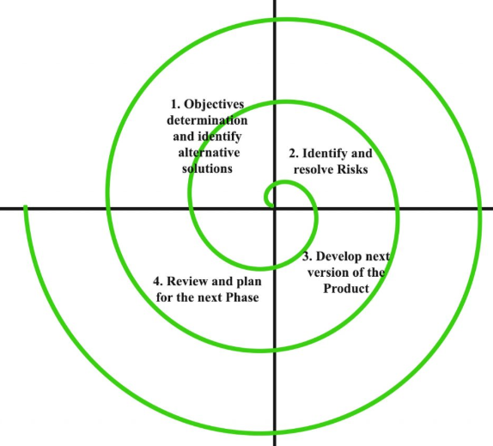
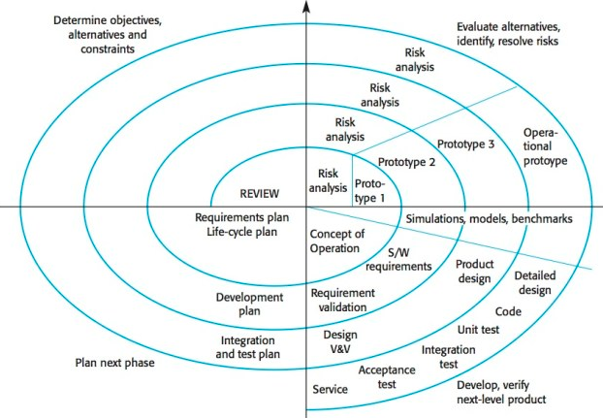

Slide 52
Spiral Model - Design
The spiral model has four phases. A software project repeatedly passes through these phases in iterations called Spirals.
IDENTIFICATION
This phase starts with gathering the business requirements in the baseline spiral. In the subsequent spirals as the product matures, identification of system requirements, subsystem requirements and unit requirements are all done in this phase.
This phase also includes understanding the system requirements by continuous communication between the customer and the system analyst. At the end of the spiral, the product is deployed in the identified market.
DESIGN
The Design phase starts with the conceptual design in the baseline spiral and involves architectural design, logical design of modules, physical product design and the final design in the subsequent spirals.
CONSTRUCT or BUILT
The Construct phase refers to production of the actual software product at every spiral. In the baseline spiral, when the product is just thought of and the design is being developed a POC (Proof of Concept) is developed in this phase to get customer feedback.
Then in the subsequent spirals with higher clarity on requirements and design details a working model of the software called build is produced with a version number. These builds are sent to the customer for feedback.
EVALUATION & RISK ANALYSIS
Risk Analysis includes identifying, estimating and monitoring the technical feasibility and management risks, such as schedule slippage and cost overrun. After testing the build, at the end of first iteration, the customer evaluates the software and provides feedback.

Slide 53
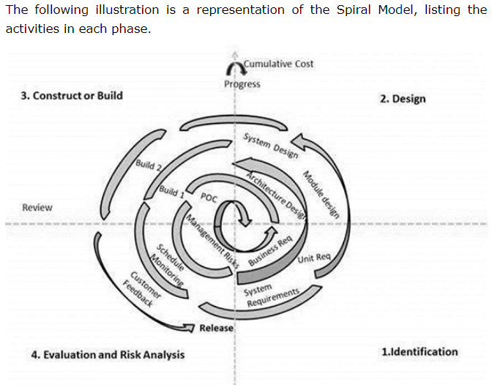
Based on the customer evaluation, the software development process enters the next iteration and subsequently follows the linear approach to implement the feedback suggested by the customer. The process of iterations along the spiral continues throughout the life of the software.

Slide 54
Spiral Model Application
The Spiral Model is widely used in the software industry as it is in sync with the natural development process of any product, i.e. learning with maturity which involves minimum risk for the customer as well as the development firms.
The following pointers explain the typical uses of a Spiral Model −
When there is a budget constraint and risk evaluation is important.
For medium to high-risk projects.
Long-term project commitment because of potential changes to economic priorities as the requirements change with time.
Customer is not sure of their requirements which is usually the case.
Requirements are complex and need evaluation to get clarity.
New product line which should be released in phases to get enough customer feedback.
Significant changes are expected in the product during the development cycle.

Slide 55
Spiral Model - Pros and Cons
The advantage of spiral lifecycle model is that it allows elements of the product to be added in, when they become available or known. This assures that there is no conflict with previous requirements and design.
This method is consistent with approaches that have multiple software builds and releases which allows making an orderly transition to a maintenance activity. Another positive aspect of this method is that the spiral model forces an early user involvement in the system development effort.
On the other side, it takes a very strict management to complete such products and there is a risk of running the spiral in an indefinite loop. So, the discipline of change and the extent of taking change requests is very important to develop and deploy the product successfully.
The advantages of the Spiral SDLC Model are as follows −
Changing requirements can be accommodated.
Allows extensive use of prototypes.
Requirements can be captured more accurately.
Users see the system early.
Development can be divided into smaller parts and the risky parts can be developed earlier which helps in better risk management.
The disadvantages of the Spiral SDLC Model are as follows −
Management is more complex.
End of the project may not be known early.
Not suitable for small or low risk projects and could be expensive for small projects.
Process is complex
Spiral may go on indefinitely.
Large number of intermediate stages requires excessive documentation.

Slide 56
PROTOTYPE MODEL
The Prototyping Model is a systems development method (SDM) in which a prototype (an early approximation of a final system or product) is built, tested, and then reworked as necessary until an acceptable prototype is finally achieved from which the complete system or product can now be developed. This model works best in scenarios where not all of the project requirements are known in detail ahead of time. It is an iterative, trial-and-error process that takes place between the developers and the users.
There are several steps in the Prototyping Model:
The new system requirements are defined in as much detail as possible. This usually involves interviewing a number of users representing all the departments or aspects of the existing system.
A preliminary design is created for the new system.
A first prototype of the new system is constructed from the preliminary design. This is usually a scaled-down system, and represents an approximation of the characteristics of the final product.
The users thoroughly evaluate the first prototype, noting its strengths and weaknesses, what needs to be added, and what should to be removed. The developer collects and analyzes the remarks from the users.
The first prototype is modified, based on the comments supplied by the users, and a second prototype of the new system is constructed.
The second prototype is evaluated in the same manner as was the first prototype.
The preceding steps are iterated as many times as necessary, until the users are satisfied that the prototype represents the final product desired.
The final system is constructed, based on the final prototype.
The final system is thoroughly evaluated and tested. Routine maintenance is carried out on a continuing basis to prevent large-scale failures and to minimize downtime.

Slide 57
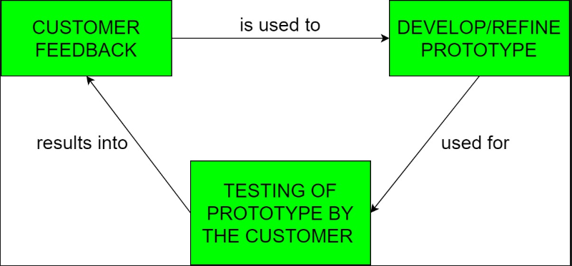
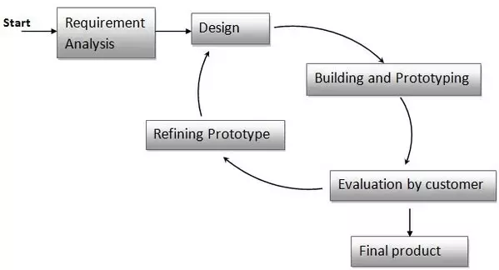
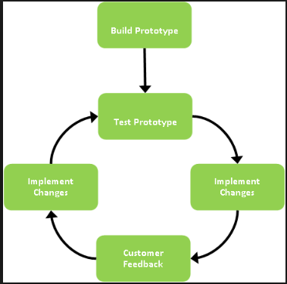

Slide 58
Software Prototyping - Pros and Cons
Software prototyping is used in typical cases and the decision should be taken very carefully so that the efforts spent in building the prototype add considerable value to the final software developed. The model has its own pros and cons discussed as follows.
The advantages of the Prototyping Model are as follows −
Increased user involvement in the product even before its implementation.
Since a working model of the system is displayed, the users get a better understanding of the system being developed.
Reduces time and cost as the defects can be detected much earlier.
Quicker user feedback is available leading to better solutions.
Missing functionality can be identified easily.
Confusing or difficult functions can be identified.

Slide 59
The Disadvantages of the Prototyping Model are as follows −
Risk of insufficient requirement analysis owing to too much dependency on the prototype.
Users may get confused in the prototypes and actual systems.
Practically, this methodology may increase the complexity of the system as scope of the system may expand beyond original plans.
Developers may try to reuse the existing prototypes to build the actual system, even when it is not technically feasible.
The effort invested in building prototypes may be too much if it is not monitored properly.

Slide 60
DSDM: Dynamic Systems Development Method
DSDM is an agile software development methodology. It is an iterative, incremental approach that is largely based on the Rapid Application Development (RAD) methodology. The method provides a four-phase framework consisting of:
Feasibility and business study
Functional model / prototype iteration
Design and build iteration
Implementation
Within each phase, DSDM relies on several different activities and techniques based on these principles:
Projects evolve best through direct and co-located collaboration between the developers and the users.
Self-managed and empowered teams must have the authority to make time sensitive and critical project-level decisions.
Design and development is incremental and evolutionary in nature and is largely driven by regular, iterative user feedback.
Working software deliverables are defined as systems that address the critical, current business needs versus systems that address less critical future needs.
Frequent and incremental delivery of working software is valued over infrequent delivery of perfectly working software.
All changes introduced during development must be reversible.
Continuous integration and quality assurance testing is conducted in-line, throughout the project lifecycle.
Visibility and transparency is encouraged through regular communication and collaboration amongst all project stakeholders.

Slide 61
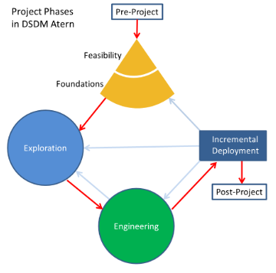
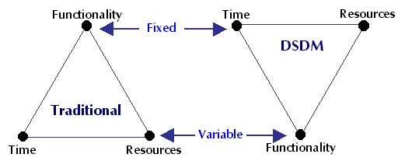
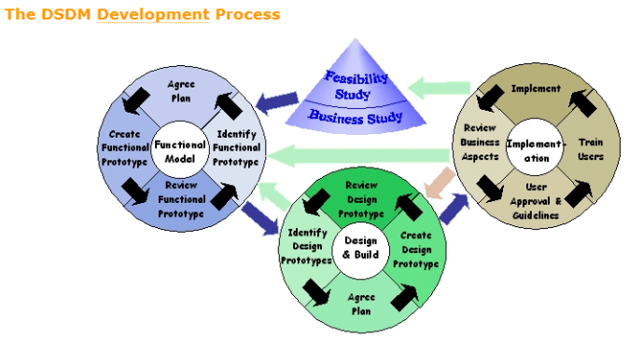

Slide 62
The eight Principles of DSDM:
Focus on the business need
Deliver on time
Collaborate
Never compromise quality
Build incrementally from firm foundations
Develop iteratively
Communicate continuously and clearly
Demonstrate control

Slide 63
Core Techniques
Timeboxing: is the approach for completing the project incrementally by breaking it down into splitting the project in portions, each with a fixed budget and a delivery date. For each portion a number of requirements are prioritized and selected. Because time and budget are fixed, the only remaining variables are the requirements. So if a project is running out of time or money the requirements with the lowest priority are omitted. This does not mean that an unfinished product is delivered, because of the Pareto Principle that 80% of the project comes from 20% of the system requirements, so as long as those most important 20% of requirements are implemented into the system, the system therefore meets the business needs and that no system is built perfectly in the first try.
MoSCoW: is a technique for prioritizing work items or requirements. It is an acronym that stands for:
MUST have
SHOULD have
COULD have
WON'T have
Prototyping: refers to the creation of prototypes of the system under development at an early stage of the project. It enables the early discovery of shortcomings in the system and allows future users to ‘test-drive’ the system. This way good user involvement is realized, one of the key success factors of DSDM, or any System Development project for that matter.

Slide 64
Testing: helps ensure a solution of good quality, DSDM advocates testing throughout each iteration. Since DSDM is a tool and technique independent method, the project team is free to choose its own test management method.
Workshop: brings project stakeholders together to discuss requirements, functionalities and mutual understanding.
Modeling: helps visualize a business domain and improve understanding. Produces a diagrammatic representation of specific aspects of the system or business area that is being developed.
Configuration management: with multiple deliverables under development at the same time and being delivered incrementally at the end of each time-box, the deliverables need to be well managed towards completion.

Slide 65
Comparison to other development framework
DSDM can be considered as part of a broad range of iterative and incremental development frameworks, especially those supporting agile and object-oriented methods. These include (but are not limited to) Scrum, Extreme Programming (XP), Disciplined Agile Delivery(DAD), and Rational Unified Process (RUP).
Like DSDM, these share the following characteristics:
They all prioritise requirements and work though them iteratively, building a system or product in increments.
They are tool-independent frameworks. This allows users to fill in the specific steps of the process with their own techniques ^{[5]} and software aids of choice.
The variables in the development are not time/resources, but the requirements. This approach ensures the main goals of DSDM, namely to stay within the deadline and the budget.
A strong focus on communication between and the involvement of all the stakeholders in the system. Although this is addressed in other methods, DSDM strongly believes in commitment to the project to ensure a successful outcome.

Slide 66
Key Success Factors
The DSDM consortium has compiled 10 most important factors from its members:
Acceptance of DSDM philosophy before starting work.
The decision making powers of users and developers inside the development team.
The commitment of senior user management to provide significant end-user involvement.
Incremental delivery.
Easy access by developers to end-users.
The stability of the team.
The development team skills.
The size of the development team.
A supportive commercial relationship.
The development technology.

Slide 67
Weakness of DSDM:
Licensing cost
Relatively high barrier to entry
Cultural shift in organization
DSDM clearly represent itself as the most mature agile development method.Even Microsoft borrows ideas from DSDM, publishing their own semi-agile solution framework. Xansa used DSDM to organize its offshore development in India.The latest version of DSDM is “DSDM Atern”. It has proven to be the robust agile framework for efficient project management which is supported and Certified by the DSDM Consortium.Not only that but also it has been nominated for the AGILE CONCEPT Awards 2011.

Slide 68
SSADM: Structured Systems Analysis And Design Method
SSADM follows the waterfall life cycle model starting from the feasibility study to the physical design stage of development.
One of the main features of SSADM is the intensive user involvement in the requirements analysis stage.
The users are made to sign off each stage as they are completed assuring that requirements are met.
The users are provided with clear, easily understandable documentation consisting of various diagrammatic representations of the system.
SSADM breaks up a development project into stages, modules, steps and tasks.
The first and foremost model developed in SSADM is the data model. It is a part of requirements gathering and consists of well defined stages, steps and products.
The techniques used in SSADM are logical data modeling, data flow modeling and entity behavior modeling.
Logical Data Modeling: This involves the process of identifying, modeling and documenting data as a part of system requirements gathering. The data are classified further into entities and relationships.
Data Flow Modeling: This involves tracking the data flow in an information system. It clearly analyzes the processes, data stores, external entities and data movement.
Entity Behavior Modeling: This involves identifying and documenting the events influencing each entity and the sequence in which these events happen.

Slide 69
Some of the important characteristics of SSADM are:
Dividing a project into small modules with well defined objectives
Useful during requirements specification and system design stage
Diagrammatic representation and other useful modeling techniques
Simple and easily understood by clients and developers
Performing activities in a sequence

Slide 70
The stages of SSADM include:
Determining feasibility
Investigating the current environment
Determining business systems options
Defining requirements
Determining technical system options
Creating the logical design
Creating the physical design
Each of these stages applies certain techniques and a sequence of analysis.
They include conventions and procedures for recording and interpreting the information with the help of diagrams and text.

Slide 71
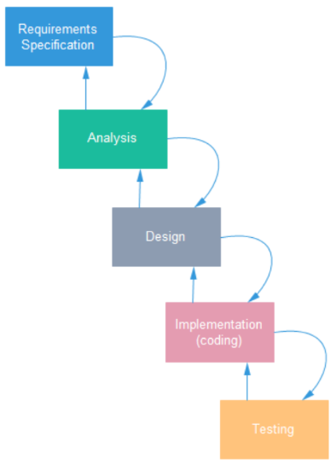

Slide 72
RAD: Rapid Application Development
The RAD (Rapid Application Development) model is based on prototyping and iterative development with no specific planning involved. The process of writing the software itself involves the planning required for developing the product.
Rapid Application Development focuses on gathering customer requirements through workshops or focus groups, early testing of the prototypes by the customer using iterative concept, reuse of the existing prototypes (components), continuous integration and rapid delivery.
What is RAD?
Rapid application development is a software development methodology that uses minimal planning in favor of rapid prototyping. A prototype is a working model that is functionally equivalent to a component of the product.
In the RAD model, the functional modules are developed in parallel as prototypes and are integrated to make the complete product for faster product delivery. Since there is no detailed preplanning, it makes it easier to incorporate the changes within the development process.
RAD projects follow iterative and incremental model and have small teams comprising of developers, domain experts, customer representatives and other IT resources working progressively on their component or prototype.
The most important aspect for this model to be successful is to make sure that the prototypes developed are reusable.

Slide 73
RAD Model Design
RAD model distributes the analysis, design, build and test phases into a series of short, iterative development cycles.
Following are the various phases of the RAD Model −
Business Modeling
The business model for the product under development is designed in terms of flow of information and the distribution of information between various business channels. A complete business analysis is performed to find the vital information for business, how it can be obtained, how and when is the information processed and what are the factors driving successful flow of information.
Data Modeling
The information gathered in the Business Modeling phase is reviewed and analyzed to form sets of data objects vital for the business. The attributes of all data sets is identified and defined. The relation between these data objects are established and defined in detail in relevance to the business model.
Process Modeling
The data object sets defined in the Data Modeling phase are converted to establish the business information flow needed to achieve specific business objectives as per the business model. The process model for any changes or enhancements to the data object sets is defined in this phase. Process descriptions for adding, deleting, retrieving or modifying a data object are given.
Application Generation
The actual system is built and coding is done by using automation tools to convert process and data models into actual prototypes.
Testing and Turnover
The overall testing time is reduced in the RAD model as the prototypes are independently tested during every iteration. However, the data flow and the interfaces between all the components need to be thoroughly tested with complete test coverage. Since most of the programming components have already been tested, it reduces the risk of any major issues

Slide 74
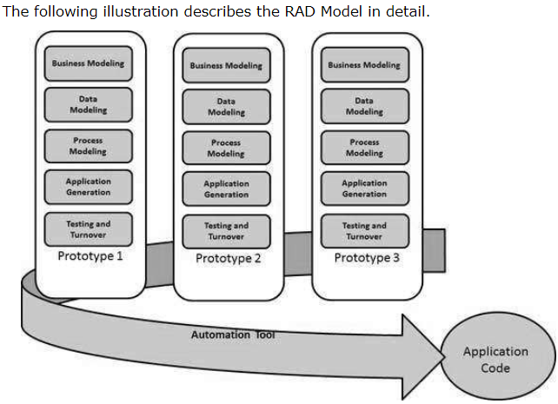

Slide 75
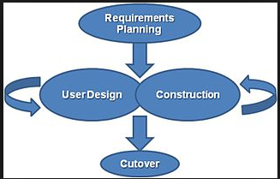
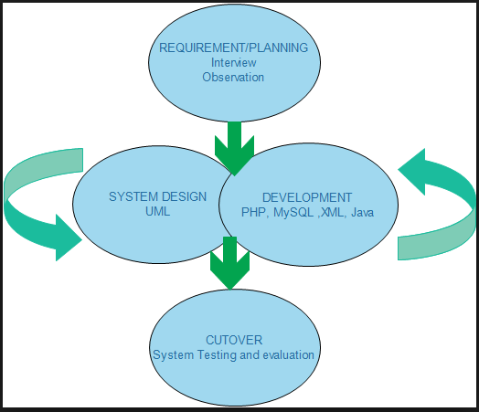
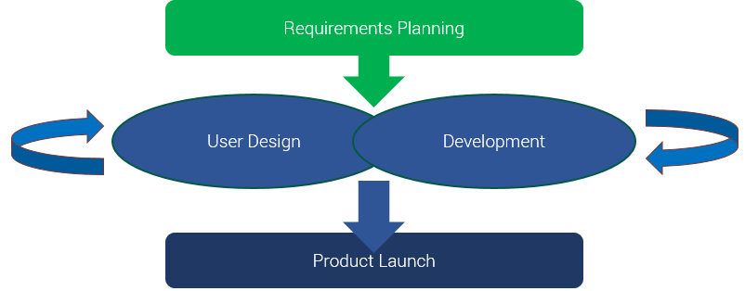

Slide 76
RAD Model Vs Traditional SDLC
The traditional SDLC follows a rigid process models with high emphasis on requirement analysis and gathering before the coding starts. It puts pressure on the customer to sign off the requirements before the project starts and the customer doesn’t get the feel of the product as there is no working build available for a long time.
The customer may need some changes after he gets to see the software. However, the change process is quite rigid and it may not be feasible to incorporate major changes in the product in the traditional SDLC.
The RAD model focuses on iterative and incremental delivery of working models to the customer. This results in rapid delivery to the customer and customer involvement during the complete development cycle of product reducing the risk of non-conformance with the actual user requirements.

Slide 77
RAD Model - Application
RAD model can be applied successfully to the projects in which clear modularization is possible. If the project cannot be broken into modules, RAD may fail.
The following pointers describe the typical scenarios where RAD can be used −
RAD should be used only when a system can be modularized to be delivered in an incremental manner.
It should be used if there is a high availability of designers for modeling.
It should be used only if the budget permits use of automated code generating tools.
RAD SDLC model should be chosen only if domain experts are available with relevant business knowledge.
Should be used where the requirements change during the project and working prototypes are to be presented to customer in small iterations of 2-3 months.

Slide 78
RAD Model - Pros and Cons
RAD model enables rapid delivery as it reduces the overall development time due to the reusability of the components and parallel development. RAD works well only if high skilled engineers are available and the customer is also committed to achieve the targeted prototype in the given time frame. If there is commitment lacking on either side the model may fail.
The advantages of the RAD Model are as follows −
Changing requirements can be accommodated.
Progress can be measured.
Iteration time can be short with use of powerful RAD tools.
Productivity with fewer people in a short time.
Reduced development time.
Increases reusability of components.
Quick initial reviews occur.
Encourages customer feedback.
Integration from very beginning solves a lot of integration issues.

Slide 79
The disadvantages of the RAD Model are as follows −
Dependency on technically strong team members for identifying business requirements.
Only system that can be modularized can be built using RAD.
Requires highly skilled developers/designers.
High dependency on modeling skills.
Inapplicable to cheaper projects as cost of modeling and automated code generation is very high.
Management complexity is more.
Suitable for systems that are component based and scalable.
Requires user involvement throughout the life cycle.
Suitable for project requiring shorter development times.

Slide 80
JAD: Joint Application Development
Joint application development (JAD) is a process originally meant for the development of computer systems, but it can be applicable to other types of development also. It is an approach of ensuring accuracy between project scope definition and delivery through continuous collaboration with the stakeholders. These interactions form the core of JAD development process and lifecycle. It is a modern means of collecting and analysing software requirements that are discussed on series of meetings and workshops between business and the technical teams.
JAD is more prevalent in agile delivery environments in which software products are developed and shipped in short cycles based on agreements between the commercial and technical stakeholders on what is known as minimum viable product (MVP). In other words, anytime there is a need for business representatives and the technology teams to deliberate and develop synergy on issues around product development or testing requirements, JAD session becomes necessary. In what is largely dependent on the size of the development project, the session may last for few hours to a day or even weeks in some cases.

Slide 81
Generic JAD Life Cycle
Planning/Definition
To complete the Planning stage, perform the following tasks:
•Designate the executive sponsor.
•Establish the need for the system.
•Select team members for the definition component.
•Define the scope of the session.

Slide 82
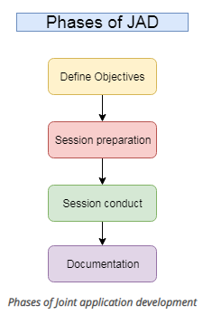
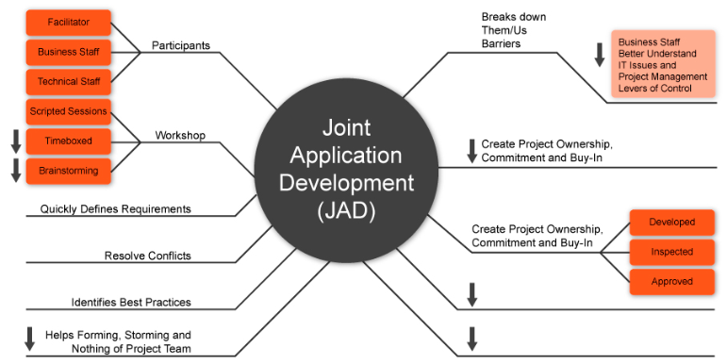

Slide 83
When to use JAD
Project Types
JAD can be successfully applied to a wide range of projects, including the following
•New systems
•Enhancements to existing systems
•System conversions
•Purchase of a system
Project Characteristics
Not all projects, however, are good candidates for JAD. An appropriate project exhibits at least some of the following characteristics:
•Involves many groups of users whose responsibilities cross traditional department or division boundaries
•Is considered critical to the future success of the organization
•Involves willing users
•Is a first-time project for the organization
•Has a troubled project history or relationship between the systems and user organizations

Slide 84
The responsibilities of JAD facilitators include the following:
Organize and schedule JAD activities.
Guide the JAD sessions.
Mediate disputes.
Encourage participation.
Maintain focus.
Enable the decision? making process by summarizing the discussions.
Have no vested interest in the outcome of the session.

Slide 85
Benefits of JAD
Benefits
The JAD approach provides the following benefits:
•Accelerates design
•Enhances quality
•Promotes teamwork with the customer
•Creates a design from the customer's perspective
•Lowers development and maintenance costs

Slide 86
JAD achieves these benefits because of the following factors:
•The decision? makers are all present.
•The facilitator keeps the group focused on the goals.
•Differing views are handled immediately.
•Most errors are caught in the Analysis and Design stages.
•The system design reflects the user's desires.
•Issues are resolved quickly.
•Assumptions are documented and understood.
•The process tends to gain momentum, not lose it.

Slide 87
END OF UNIT ONE
☺

Slide 88
UNIT 2
PROCESS & CONCEPTUAL MODELING
Introduction to Data Flow Diagram (DFD)
Concepts Used in Drawing DFDs
DFD Design (Level 1)
Conceptual Modeling
Entity Relationship Diagrams

Slide 89
UNIT 3
Data and Process Modeling
Introduction
Overview of Data & Process Modeling Tools
Data Dictionary (Introduction to CASE)
Using CASE Tools for Documentation
Documenting the data elements
Documenting the data stores
Documenting the processes
ERD
Data dictionary reports

Slide 90
UNIT 4
LOGICAL MODELING
Decision Table
Decision Tree
Structured English
Data Dictionary

Slide 91
UNIT 5
OBJECT MODELING
Overview of Object-Oriented Analysis
Object Modeling with the Unified Modeling Language
Flow Diagram
System Diagram
Activity Diagram
Use Case Diagram

Slide 92
UNIT 6
SYSTEM ANALYSIS
System Planning and initial investigation
Project Scheduling
Requirement Analysis
Types of requirements
Requirement gathering methods
Feasibility Study and its types
Steps of feasibility study
Cost/benefit analysis (Payback methods, NPV methods)

Slide 93
UNIT 7
SYSTEMS DESIGN
Introduction to system design
The process and stages of system design
Logical and physical design
Introduction to structured design
Database design and overview of file organization
Input/Output and forms design

Slide 94
UNIT 8
SYSTEM IMPLEMENTATION
Introduction to system implementation
System Installation and its types
System quality, software quality assurance
System maintenance, type of maintenance and process of system maintenance
Introduction to system testing

